Slide 1
Iris Flower Classification with Interactive GUI
Name – ABDULLAH MD SHAMIM
UNID: UMID17052536986
DATA SCIENCE INTERN
UNIFIED MENTORS

Slide 2
Introduction to the Project
The Iris dataset is one of the most well-known datasets in the machine learning community, originally introduced by Ronald A. Fisher.
The dataset contains measurements of iris flowers from three different species: Setosa, Versicolor, and Virginica.
This project aims to build a machine learning classifier to identify the species of an iris flower using four numerical features.
Additionally, it includes the development of a desktop application with a Graphical User Interface (GUI) using Tkinter to make predictions more user-friendly and interactive.

Slide 3
Problem Statement and Objective
Problem Statement: Given the sepal and petal measurements of an iris flower, predict its species accurately.
Objectives:
Load and explore the dataset
Perform data cleaning and preprocessing
Train and evaluate a classification model
Build an intuitive GUI for real-time predictions
Ensure accuracy and usability of the final solution

Slide 4
Dataset Description
Source: UNIFIED MENTORS
Total Records: 150 (147 after removing duplicates)
Features:
Sepal Length (cm)
Sepal Width (cm)
Petal Length (cm)
Petal Width (cm)
Classes:
Iris-setosa
Iris-versicolor
Iris-virginica
All features are continuous numerical values and the target is categorical.

Slide 5
Tools and Technologies Used
Programming Language: Python 3.11
Libraries & Frameworks:
Pandas, NumPy – for data handling and manipulation
Matplotlib, Seaborn – for data visualization
Scikit-learn – for model building and evaluation
Joblib – for model serialization
Tkinter – for GUI development
IDE: Jupyter Notebook (for ML pipeline), VS Code (for GUI application)

Slide 6
Exploratory Data Analysis (EDA)
Checked for null values (None found)
Identified and removed 3 duplicate entries
Visualized class distribution using count plots
Used pair plots to explore relationships between features
Created correlation heatmaps and boxplots to examine feature patterns across classes
Insights:
Petal length and width are most discriminative between classes
Setosa class is linearly separable from the others

Slide 7
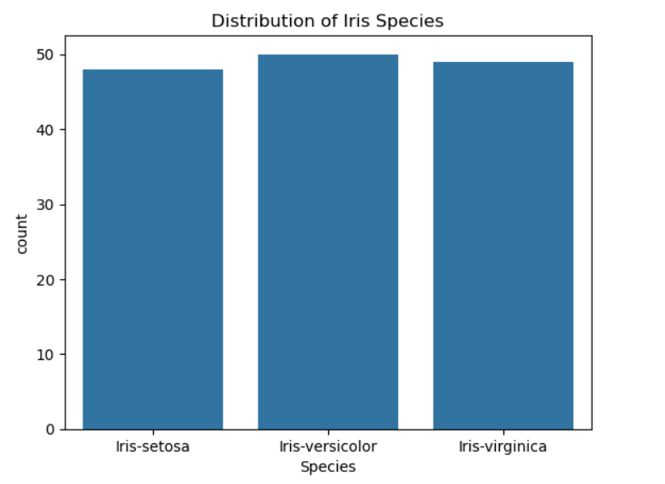

Slide 8
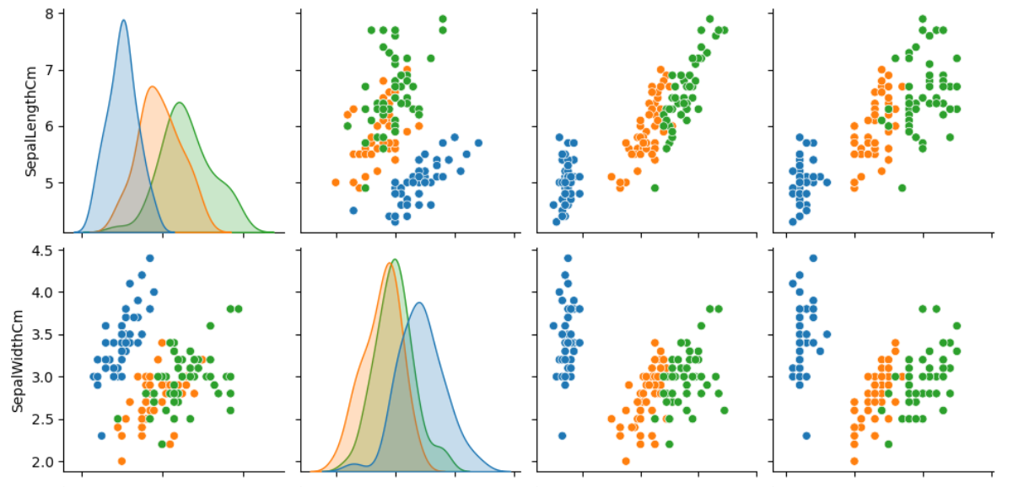
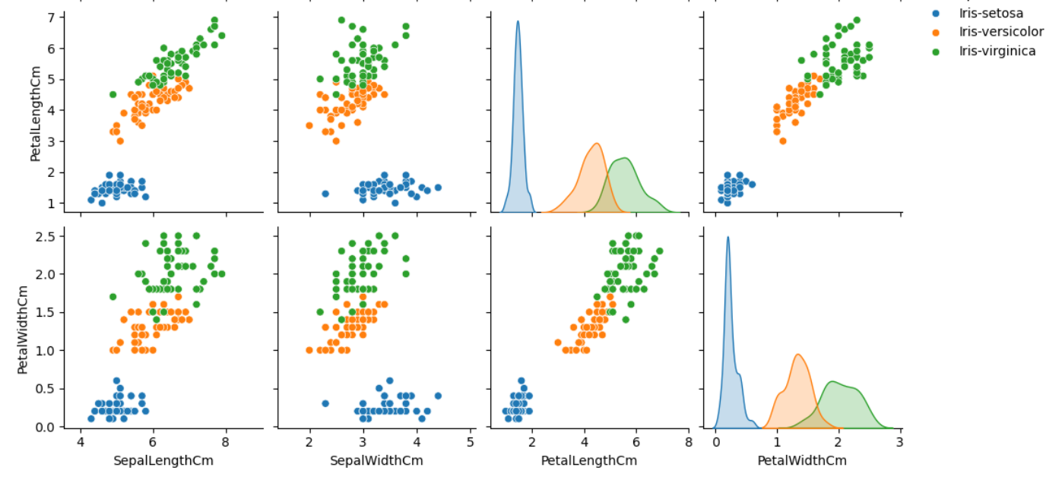

Slide 9
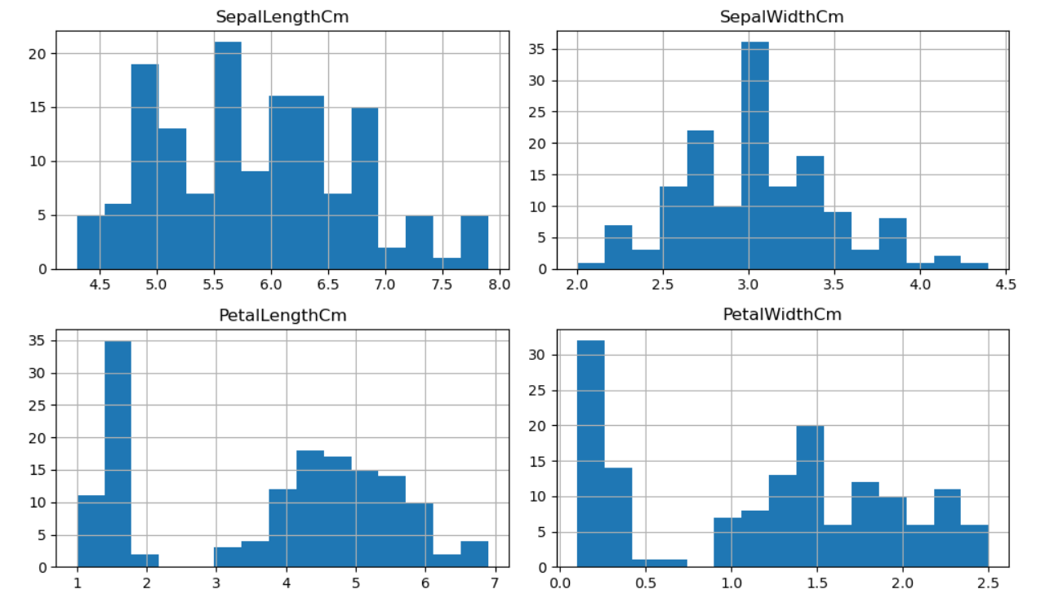

Slide 10
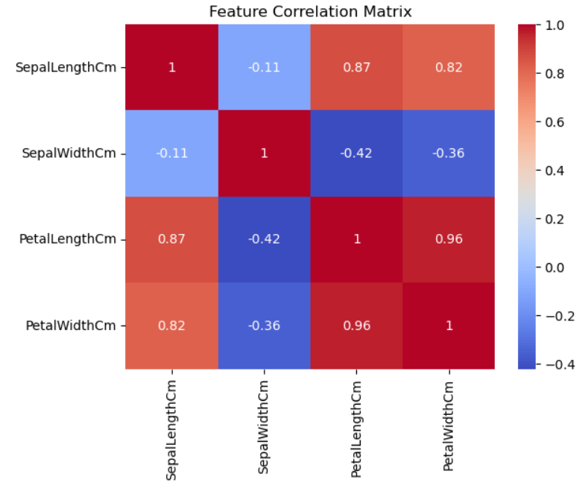

Slide 11
Data Preprocessing Steps
Label Encoding: Converted class labels into numeric values
Setosa → 0
Versicolor → 1
Virginica → 2
Train-Test Split:
80% training, 20% testing (stratified sampling)
Standard Scaling:
Applied StandardScaler to normalize feature values
Ensures better model convergence and comparability across features

Slide 12
Model Training
Chose K-Nearest Neighbors (K=3) as the classification model
Reasons:
Simple and intuitive
Non-parametric and good for small datasets
Training process:
Fit the model using the training set
Saved the trained model and scaler using joblib

Slide 13
Error Analysis
Only 2 misclassifications, both between Versicolor and Virginica.
Likely caused by overlapping petal measurements.
Error analysis helps identify areas for potential feature engineering.

Slide 14
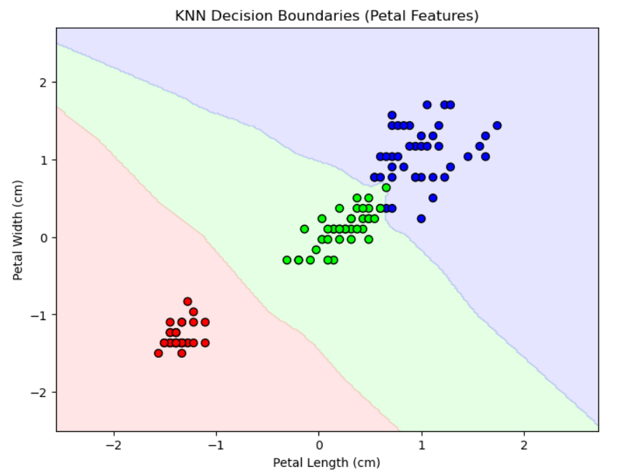
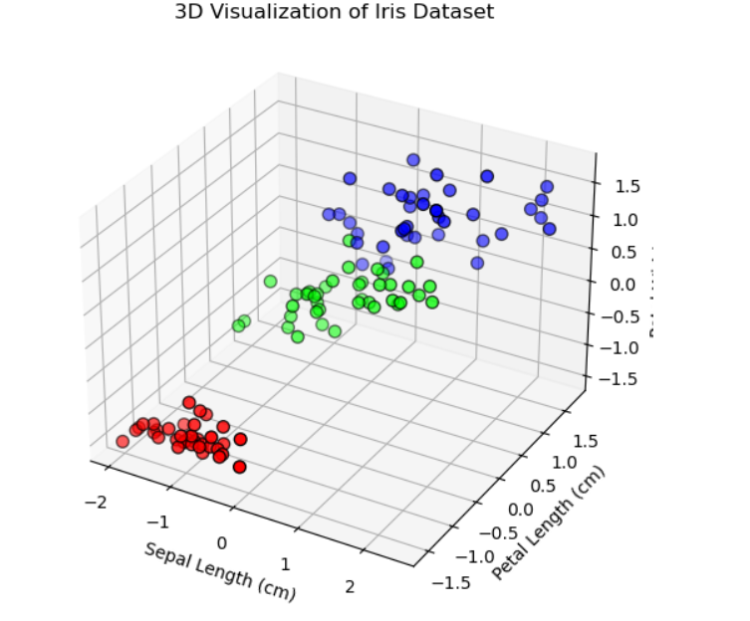

Slide 15
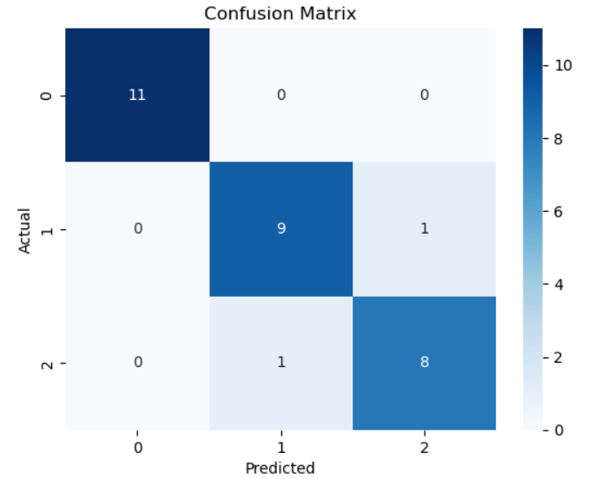
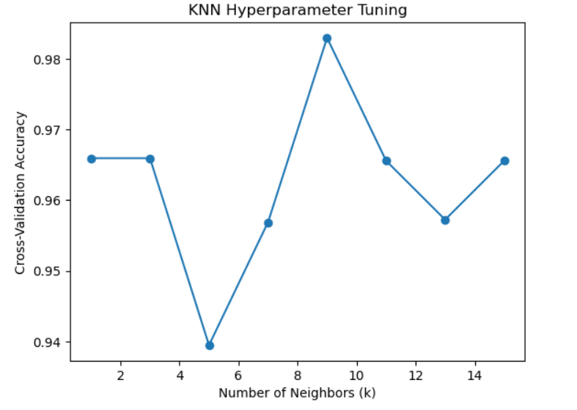

Slide 16
Visualization – Decision Boundaries
2D plot using Petal Length and Petal Width.
Shows how KNN separates different species in feature space.
Color-coded regions make boundaries between classes clear.

Slide 17
Visualization – 3D Scatter Plot
Uses Sepal Length, Petal Length, and Petal Width.
3D view highlights separability of classes.
Enhances interpretability for non-technical audiences.

Slide 18
Model Evaluation and Results
Accuracy on Test Set: 93.3%
Confusion Matrix:
2 minor misclassifications
Classification Report:
Precision and recall above 89% for all classes
Setosa class: 100% precision and recall
Model is interpretable, stable, and efficient for this use case

Slide 19
GUI Design and Implementation
Built using Python's standard Tkinter library
Components:
4 input fields for user to enter sepal and petal dimensions
A 'Predict' button to trigger model inference
Display area to show predicted species name
Workflow:
User inputs measurements
GUI scales data using saved scaler
Model makes prediction
Predicted class is shown on the interface

Slide 20
Benefits of GUI Integration
No need for users to understand code or use Jupyter
Real-time prediction from user input
Easy for faculty, evaluators, and non-technical users
Shows practical deployment of ML models
Lightweight and requires no internet or web hosting

Slide 21
Challenges and Solutions
Multiple Python versions: Used consistent environment with Python 3.11
Package issues: Installed missing packages (joblib, scikit-learn) using pip
Model not loading initially: Fixed by aligning versions and using correct .pkl structure
GUI crashes or freezes: Handled user input errors with proper validation and error messages

Slide 22
Conclusion
Completed a full ML pipeline:
Data loading → EDA → Preprocessing → Modeling → GUI Deployment
Achieved strong classification performance (93.3%)
GUI ensures accessibility and usability
Project is practical, intuitive, and industry-relevant
A solid addition to academic portfolio and internship experience

Slide 23
Contact Info:
Name: Abdullah Md Shamim
Email: abdullahshamim7584@gmail.com
LinkedIn: https://www.linkedin.com/in/abdullah-shamim-497ba434a/

